Slide 1
Dijkstra vs A*
An interactive demo comparing two classic search algorithms to the same optimal route
Presented by: Shubham Aryal [ KAN 080 BCT 058]
Siddhanta Mani Pandey [ KAN 080 BCT 060]
Supreme Adhikari [KAN 080 BCT 066]

Slide 2
THE REAL-LIFE PROBLEM
Finding the shortest route on a map full of obstacles
1
GPS navigation
2
Robot & drone motion planning
Google/Apple Maps route you from A to B around closed roads and traffic.
A warehouse robot or drone must reach a target while avoiding shelves, walls, people.
3
Game AI pathing
4
Network routing
NPCs and units in games navigate maps full of terrain and obstacles in real time.
Data packets are routed through the cheapest path across a graph of routers.
All of these reduce to the same abstract question: on a grid / graph with weighted edges, what is the cheapest path from a start node to a goal node?
02

Slide 3
Dijkstra's Algorithm
Uninformed search: expands the cheapest-so-far node, in every direction, until it stumbles onto the goal.
How it works
Priority function
1
Keep a priority queue of nodes, ordered by total cost-so-far from the start.
priority(n) = g(n)
2
Pop the cheapest node; mark it visited; this cost is now final (proven shortest).
g(n) = exact cost accumulated from the start to node n
3
Relax its neighbors: if reaching a neighbor through this node is cheaper, update its cost.
No sense of direction
Because Dijkstra only looks at cost-so-far, it explores equally in every direction — like ripples spreading in a pond — even the half of the map that points away from the goal.
4
Repeat until the goal is popped — guaranteed to be the shortest path.
03

Slide 4
A* Search
Informed search: adds a heuristic estimate of remaining distance, so the search 'leans' toward the goal.
How it works
Priority function
1
Same priority-queue structure as Dijkstra — but rank by cost-so-far PLUS an estimate of what's left.
priority(n) = g(n) + h(n)
2
The estimate (heuristic) is typically Manhattan or Euclidean distance to the goal.
h(n) = heuristic estimate of the remaining cost from n to the goal
3
Nodes that look 'closer to the goal' get explored first, pruning the search cone.
A built-in compass
The heuristic acts like a compass pointing at the goal, so A* forms a narrow, directed cone of exploration instead of a wide circle.
4
As long as the heuristic never overestimates (is 'admissible'), the path found is still optimal.
04

Slide 5
Comparision
Same guarantee, different amount of work
 | Dijkstra | A*
Search type | Uninformed (blind) | Informed (goal-aware)
Priority used | g(n) — cost so far | g(n) + h(n) — cost so far + estimate
Exploration shape | Expands evenly outward (circle) | Expands toward the goal (cone)
Optimal path? | Yes, always | Yes — if heuristic is admissible
Typical use case | Unweighted / unknown-goal-direction graphs, network routing | Maps, games, robotics — anywhere direction to goal is known
Both algorithms are guaranteed to find the shortest path — A* just usually gets there having looked at far fewer nodes.
05

Slide 6
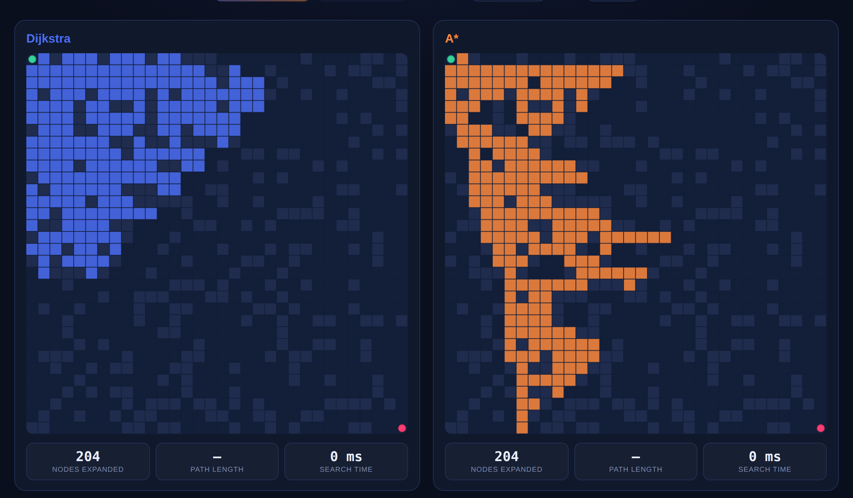
LIVE ANIMATED DEMO
Watching the search frontiers race in real time
Same maze, same start/goal. Blue = Dijkstra's frontier, orange = A*'s frontier, green = final shortest path.
At the same number of nodes expanded, Dijkstra's frontier is a wide blob covering both useful and useless territory — A*'s frontier is a narrow funnel aimed straight at the goal.
06

Slide 7
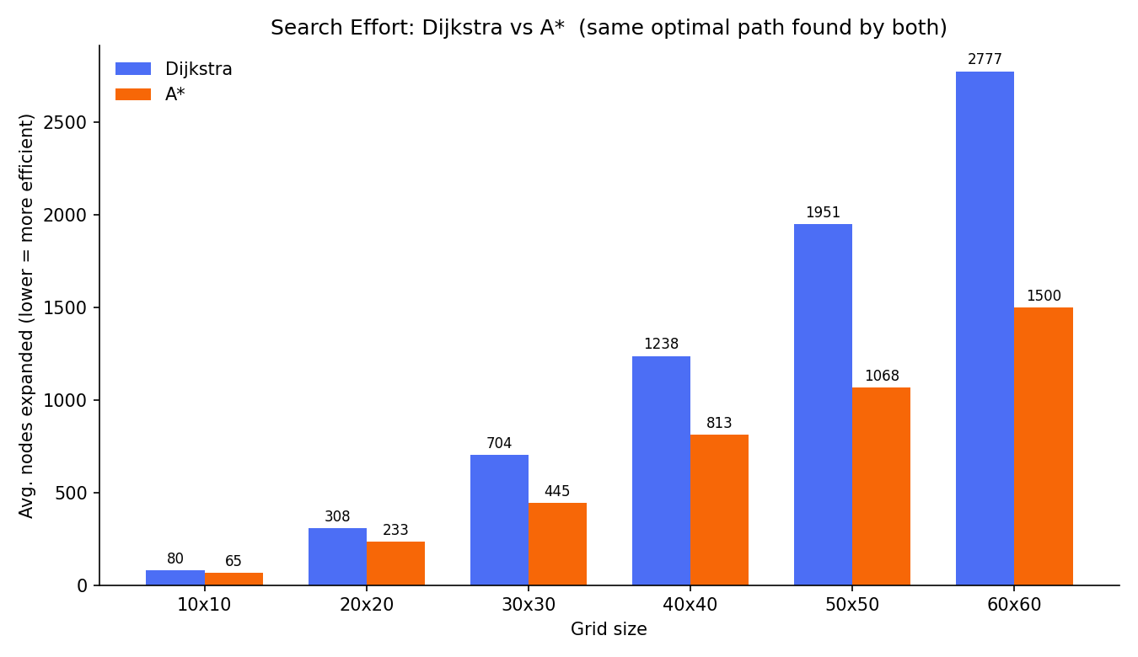
BENCHMARK · SEARCH EFFORT
A* consistently expands fewer nodes
Averaged over 8 random mazes per grid size (22% obstacle density). Both algorithms always returned the identical optimal path length.
Up to a 46% reduction in nodes explored on the largest 60×60 grid — the gap widens as the map grows.
07

Slide 8
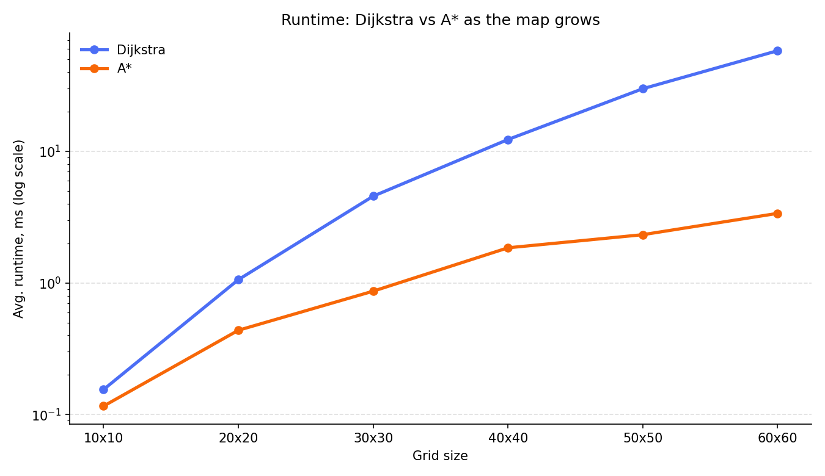
BENCHMARK · RUNTIME
Less work translates directly into wall-clock speed
Log-scale runtime in milliseconds. This is a pure Python implementation — the gap would be even more pronounced on larger, real-world maps.
On the 60×60 grid, A* finished roughly 17× faster than Dijkstra (3.4 ms vs 58 ms average).
08

Slide 9
CONCLUSION
Which one should you actually use?
Use Dijkstra when...
Use A* when...
• You don't have (or can't trust) a good heuristic
• You have one specific goal and a sensible distance estimate
• You need shortest paths to EVERY node, not just one goal
• Performance matters — maps, games, and robotics all default to A*
• The graph has no useful notion of 'direction' (e.g. abstract networks)
• You want Dijkstra's optimality guarantee without the wasted search
09

Slide 10
FURTHER READING
Reading material & references
Dijkstra, E. W. (1959)
“A Note on Two Problems in Connexion with Graphs.” Numerische Mathematik — the original paper.
Hart, Nilsson & Raphael (1968)
“A Formal Basis for the Heuristic Determination of Minimum Cost Paths.” IEEE — the original A* paper.
Red Blob Games — Introduction to A*
redblobgames.com/pathfinding/a-star/introduction.html — the best interactive visual explainer available.
CLRS, “Introduction to Algorithms”
Chapter 24 (Single-Source Shortest Paths) covers Dijkstra's algorithm and proofs rigorously.
Russell & Norvig, “AI: A Modern Approach”
Chapter 3 (Solving Problems by Searching) — A*, heuristics, and admissibility/consistency.
Stanford CS221 / CS229 lecture notes
Search & heuristics lecture notes — free course material covering both algorithms with examples.
Project files: algorithms.py · benchmark.py · pathfinding_race.html (interactive demo)
10

